Slide 1
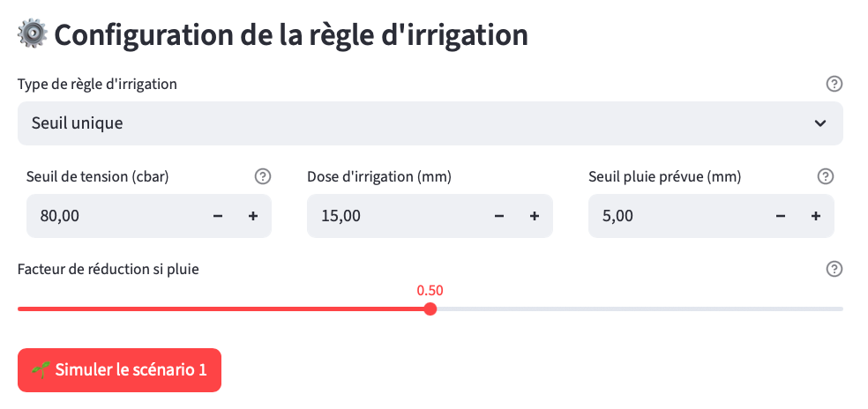

Slide 2
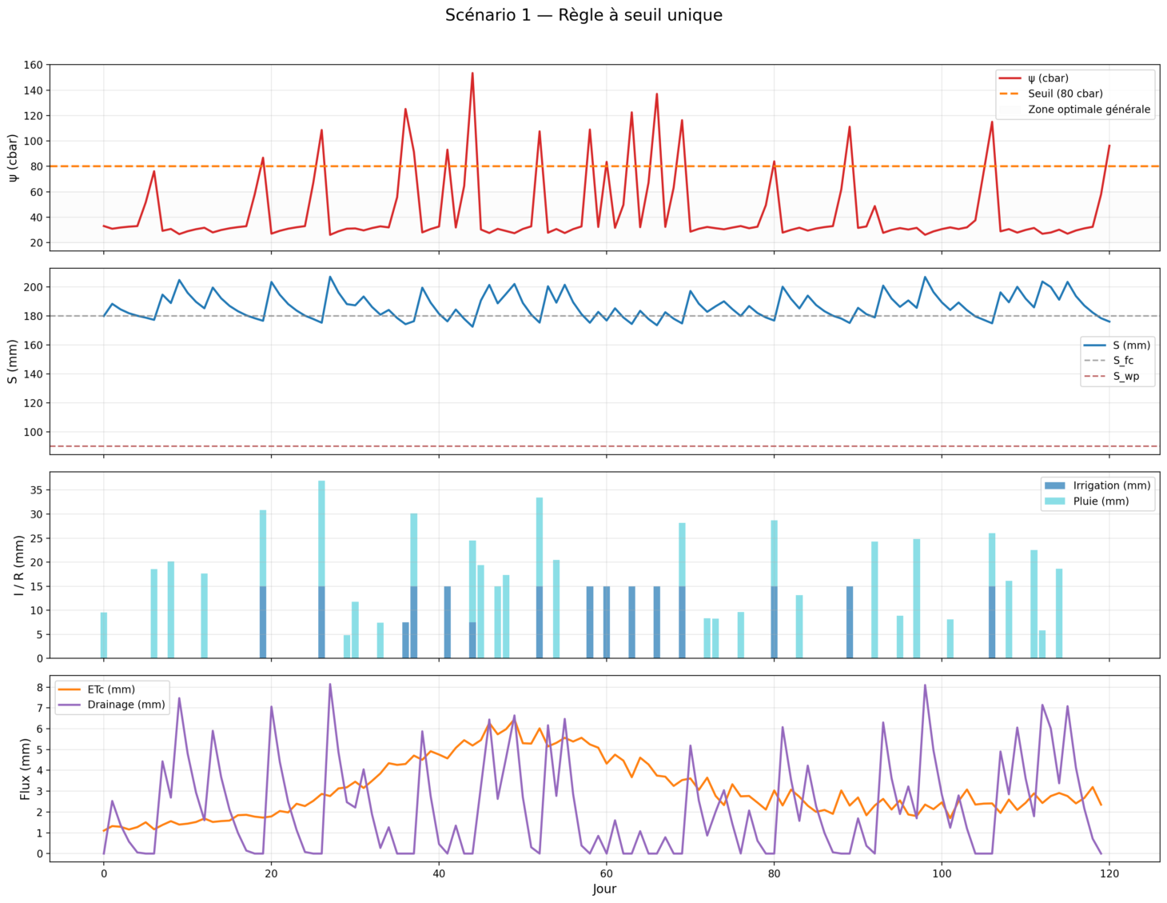
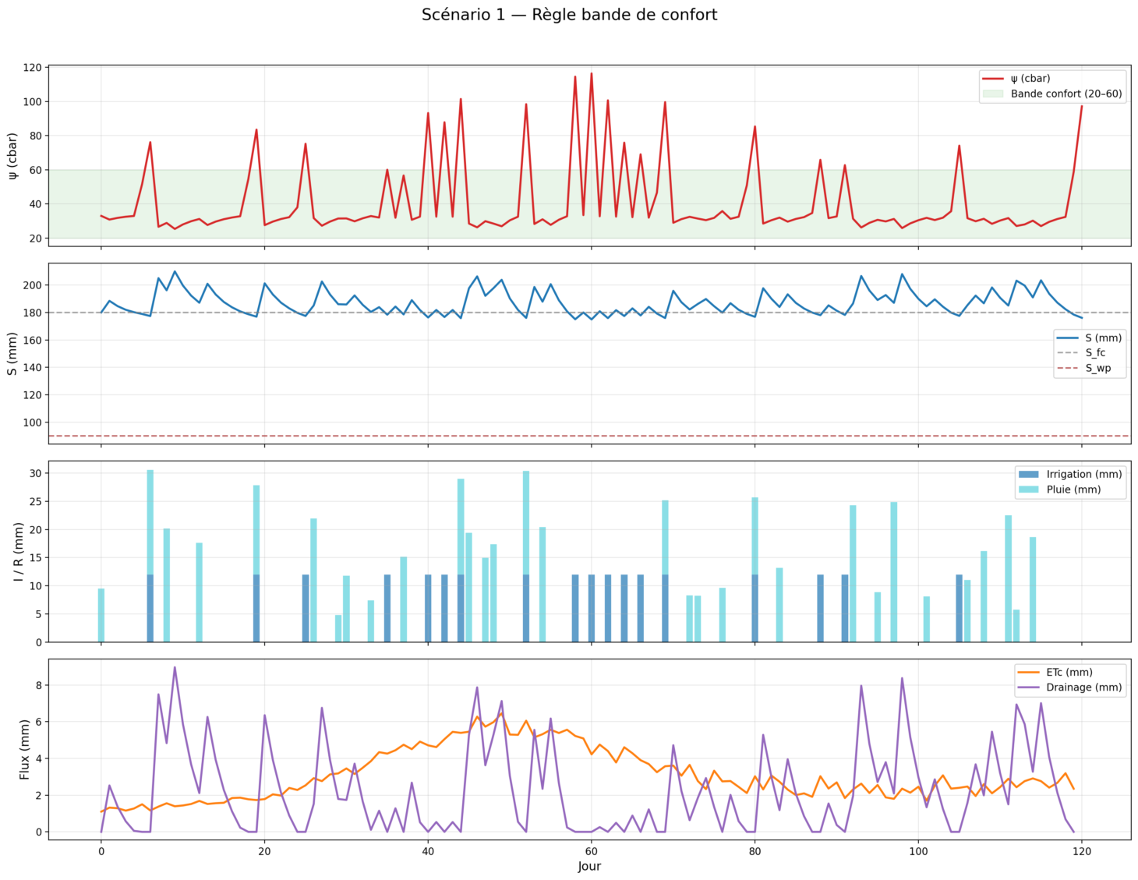
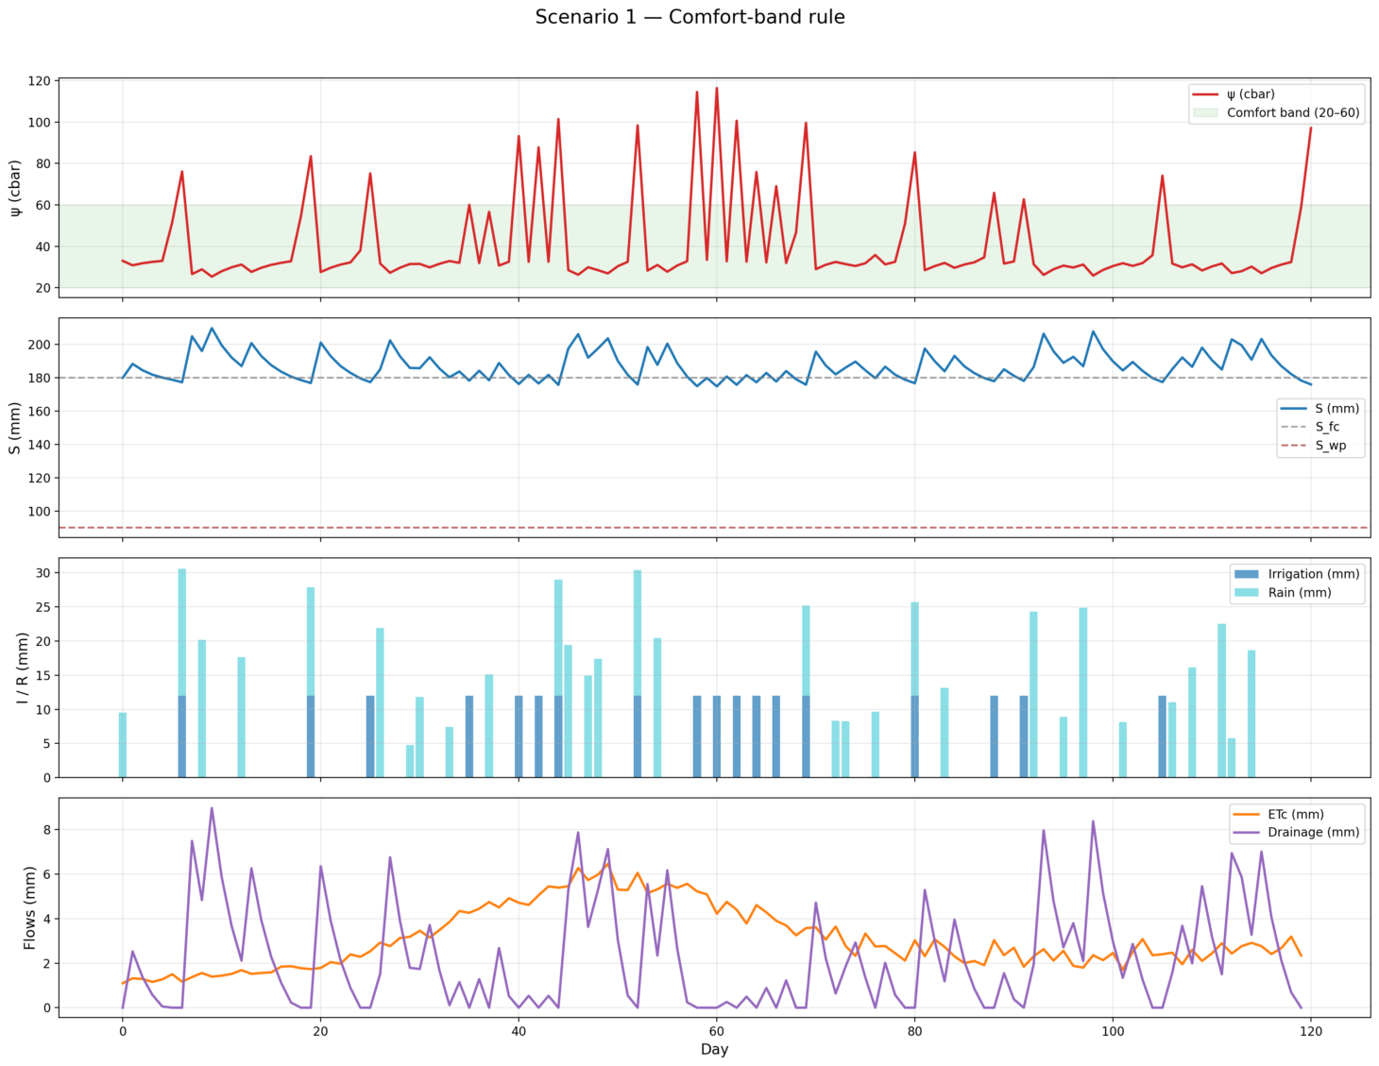

Slide 3
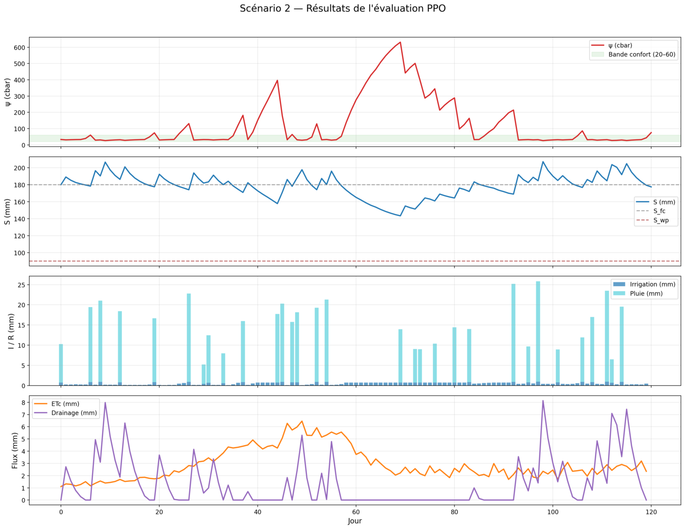
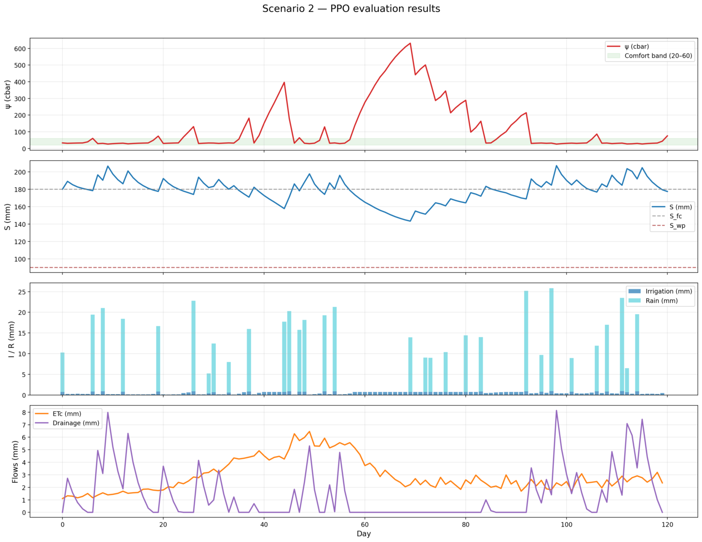

Slide 4
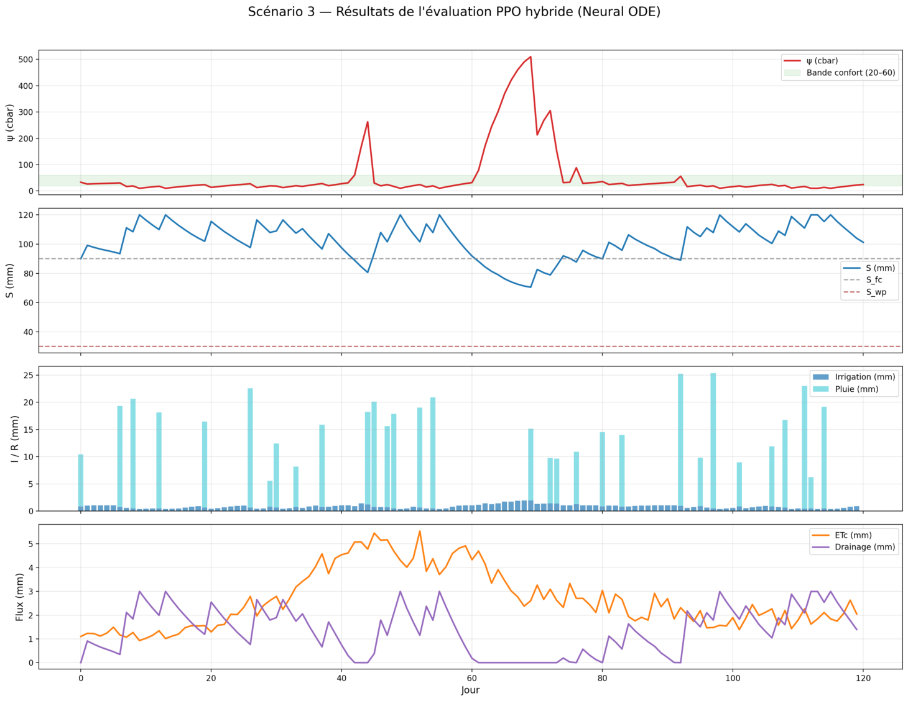
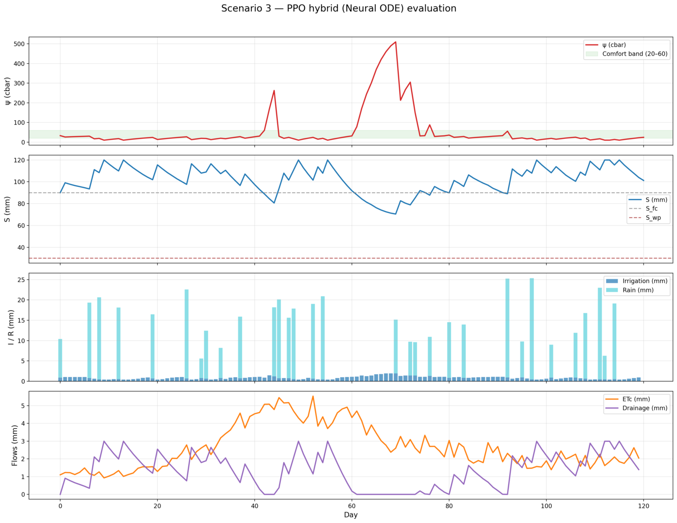

Slide 5
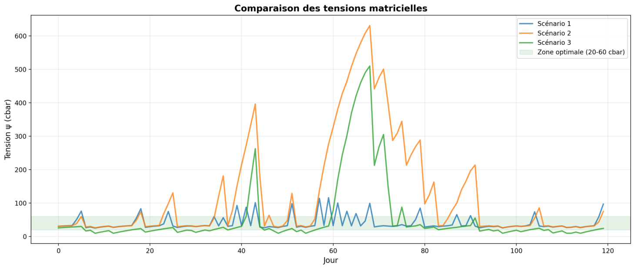
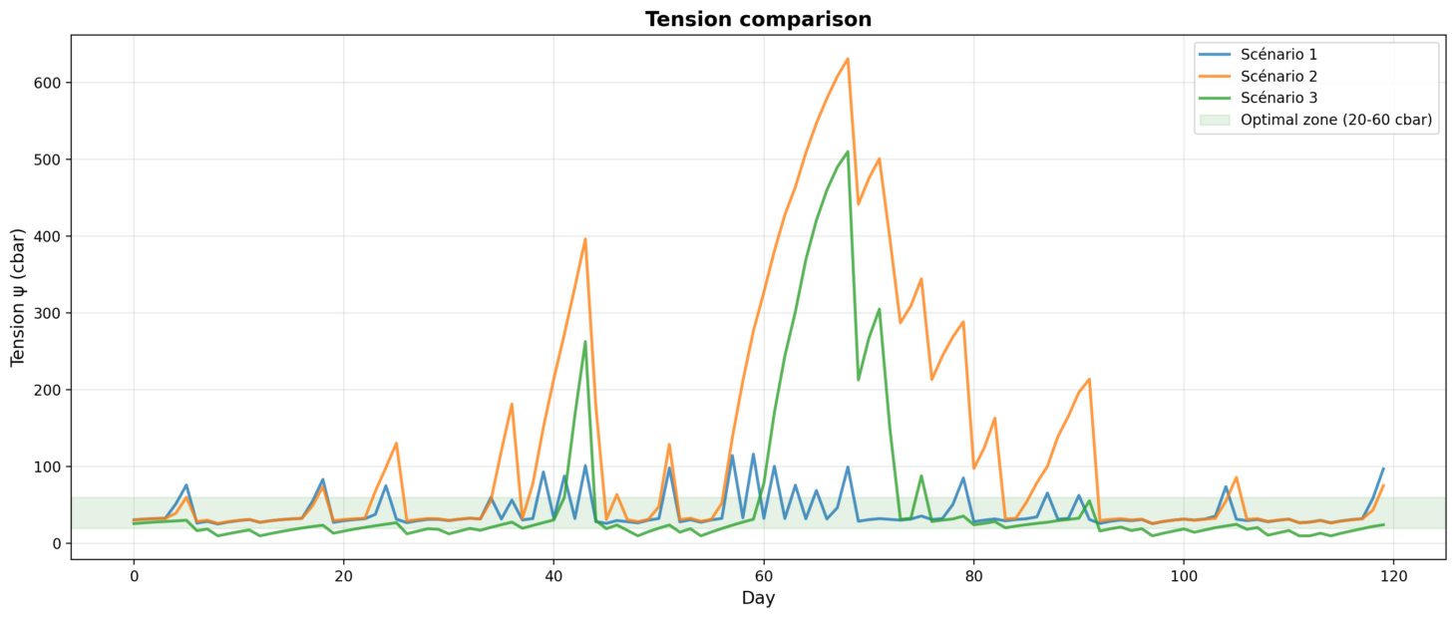
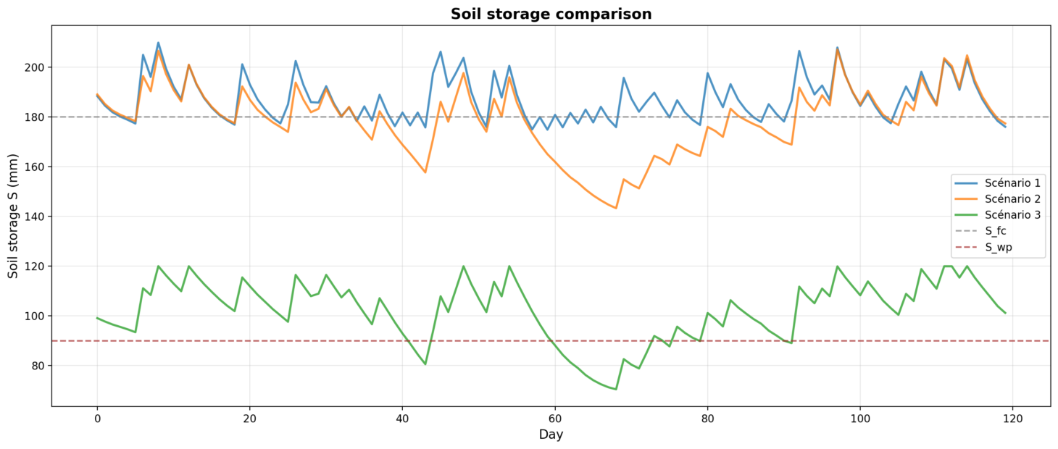
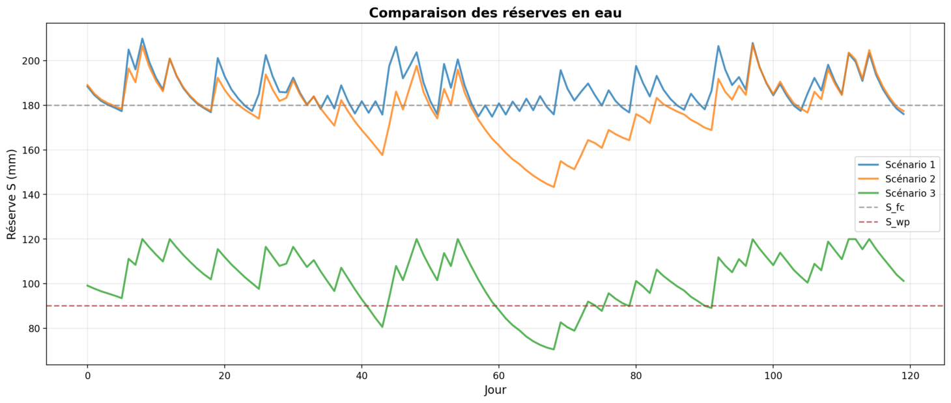

Slide 6
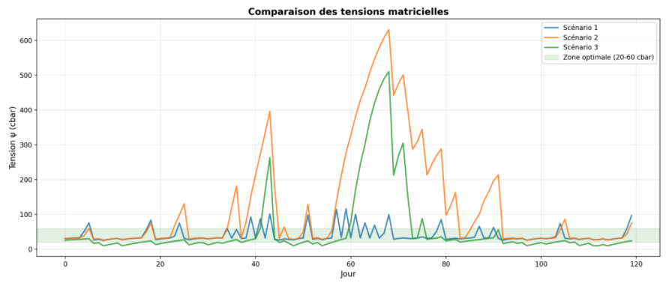
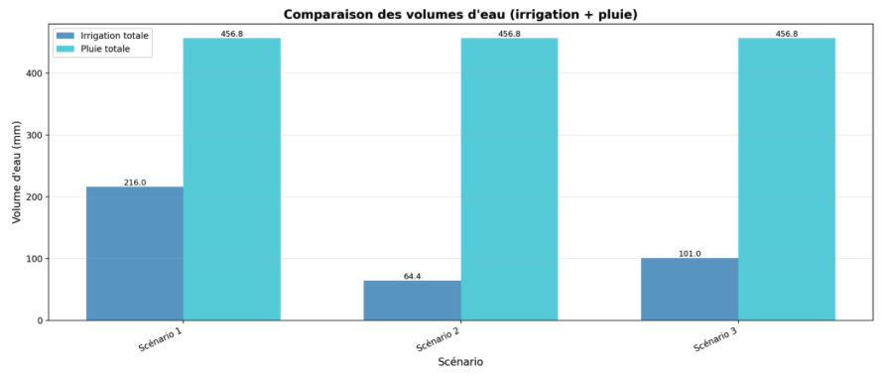
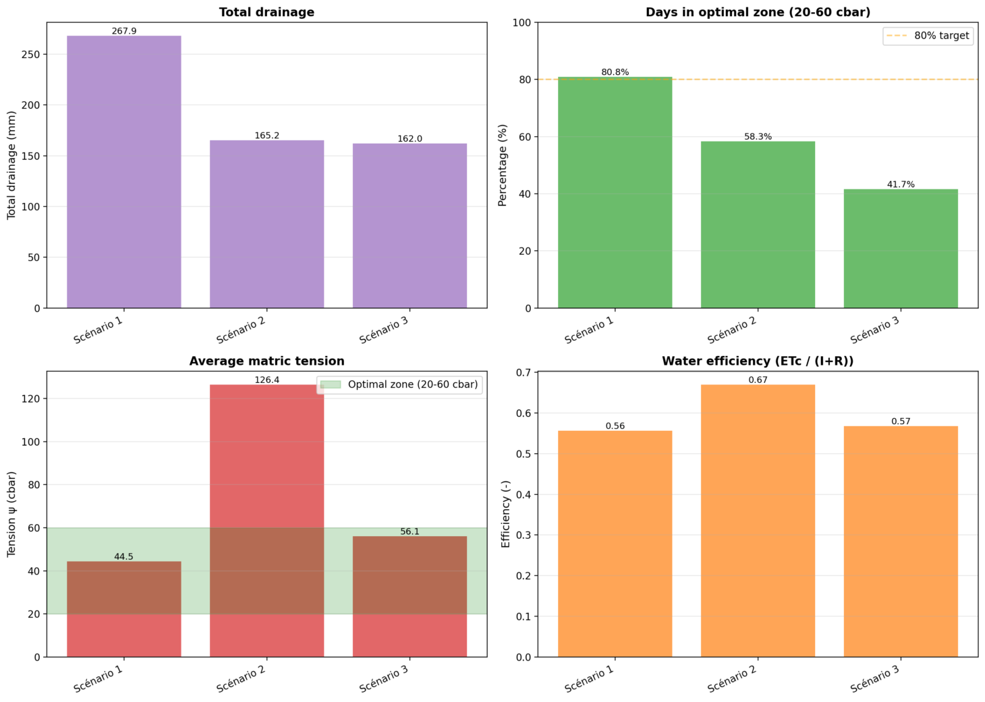
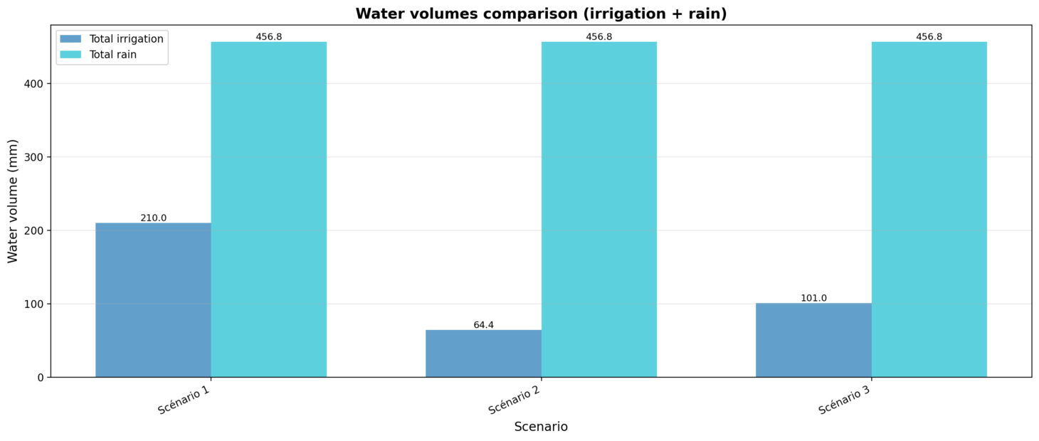
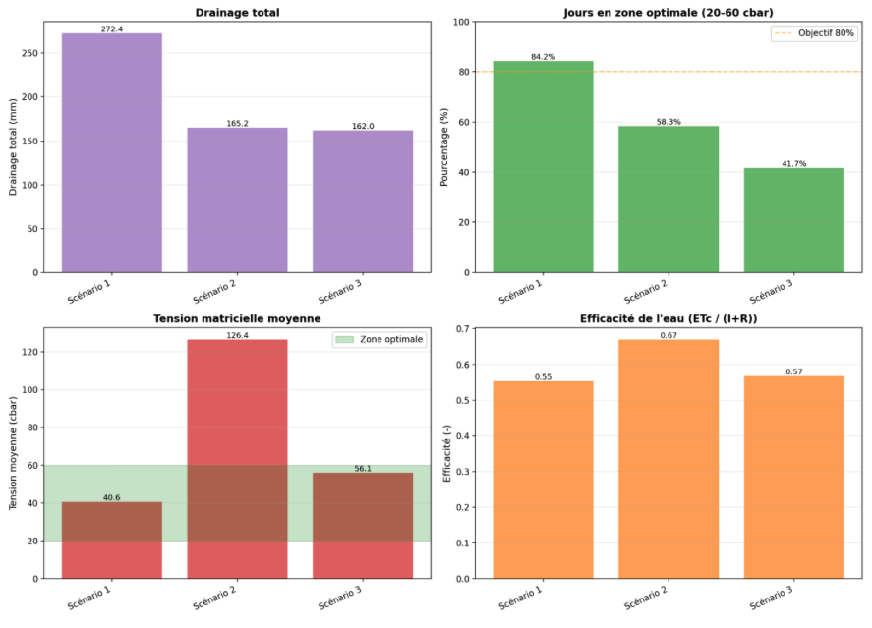
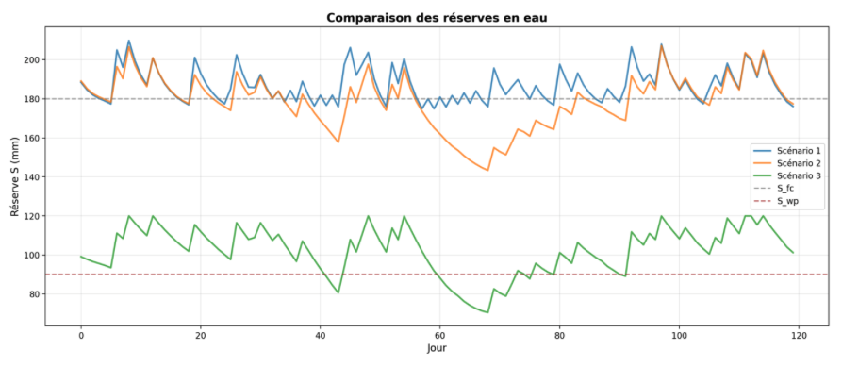

Slide 7
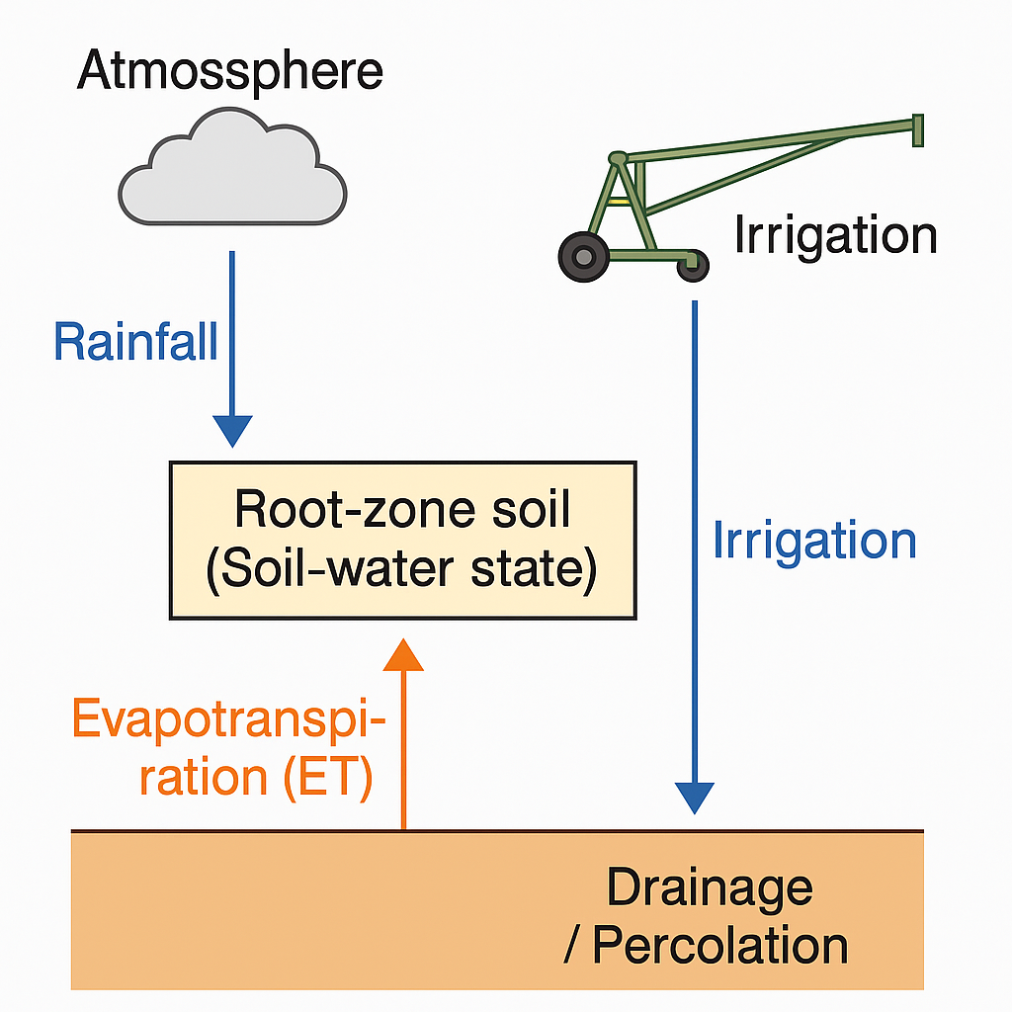
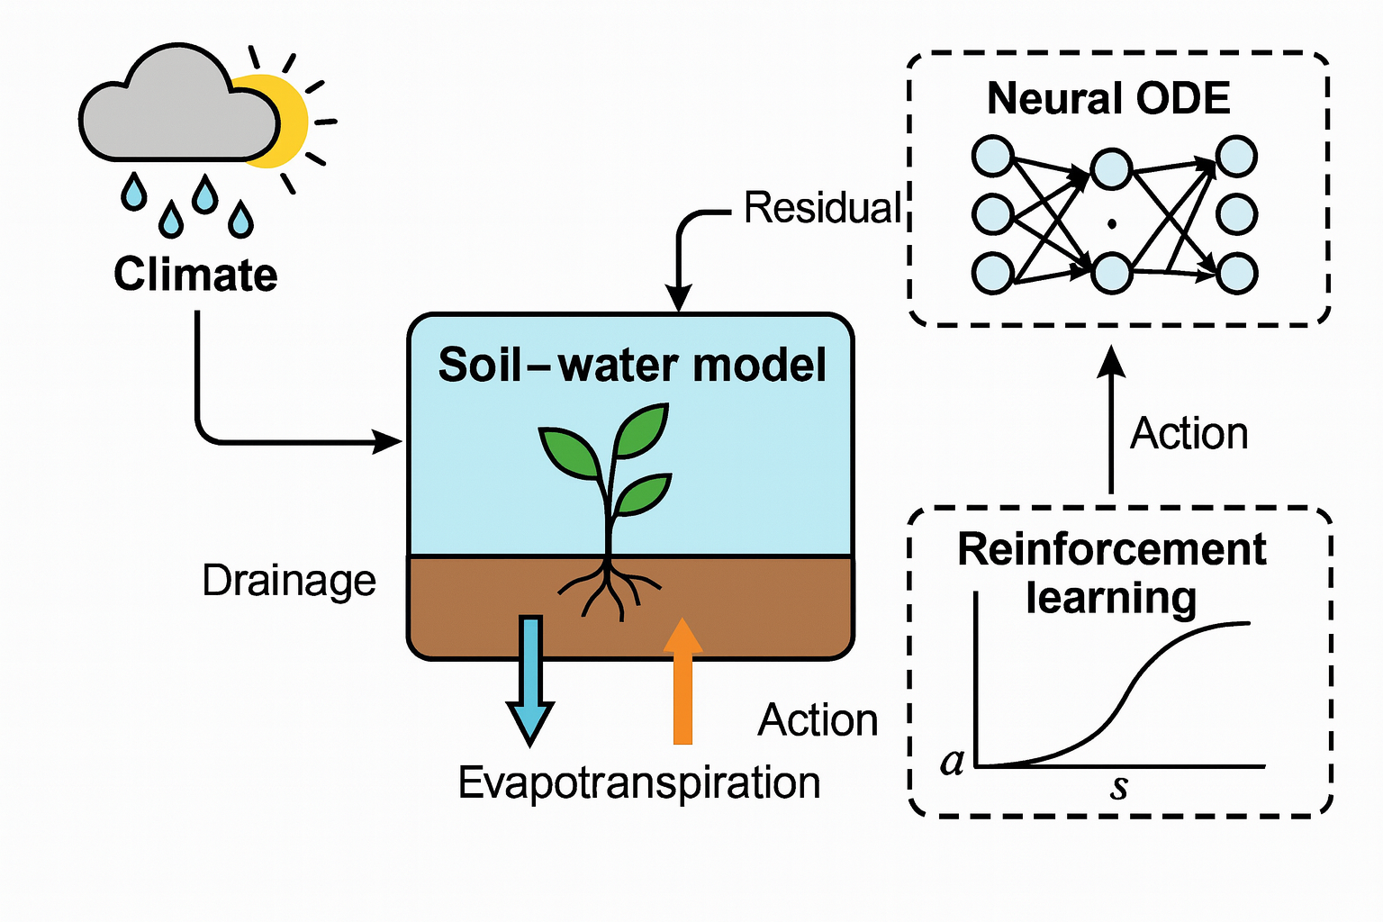

Slide 8
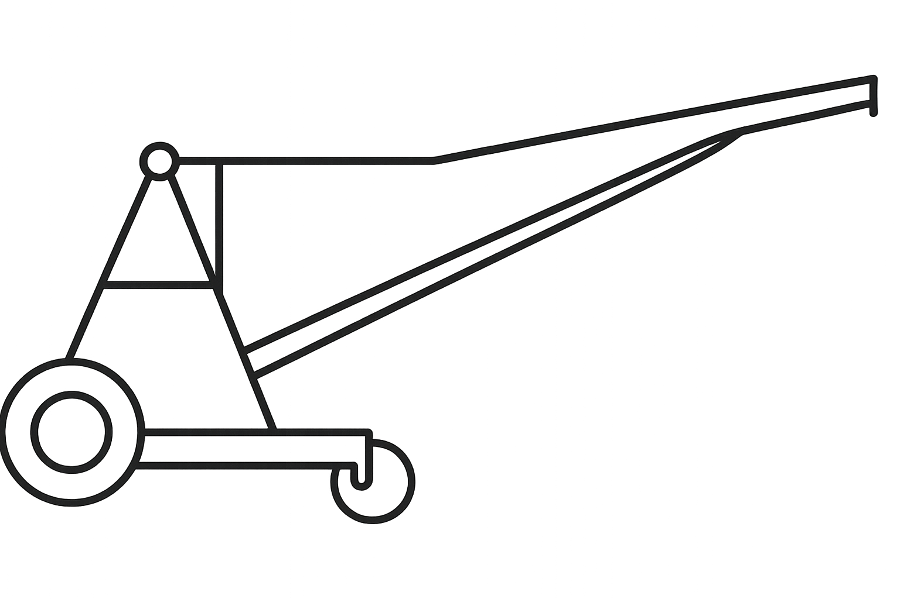





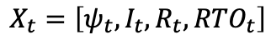
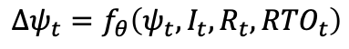
(irrigation dose)
action
ENVIRONMENT
PPO
irrigation
rain
evapotranspiration
reward
transpiration
(water stress/use, drainage)
evaporation
$$X_{t}=\left[ψ_{t},I_{t},R_{t},{RTO}_{t}\right]$$
N-ODE
drainage
$${Δψ}_{t}=f_{θ}\left(ψ_{t},I_{t},R_{t},{RTO}_{t}\right)$$

Slide 9
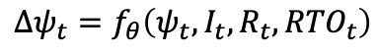
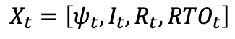
(irrigation dose)
action
PPO
irrigation
rain
evapotranspiration
reward
transpiration
(water stress/use, drainage)
evaporation
$$X_{t}=\left[ψ_{t},I_{t},R_{t},{RTO}_{t}\right]$$
N-ODE
drainage
$${Δψ}_{t}=f_{θ}\left(ψ_{t},I_{t},R_{t},{RTO}_{t}\right)$$

Slide 10
irrigation
pluie
évapotranspiration
transpiration
évaporation
drainage

Slide 11
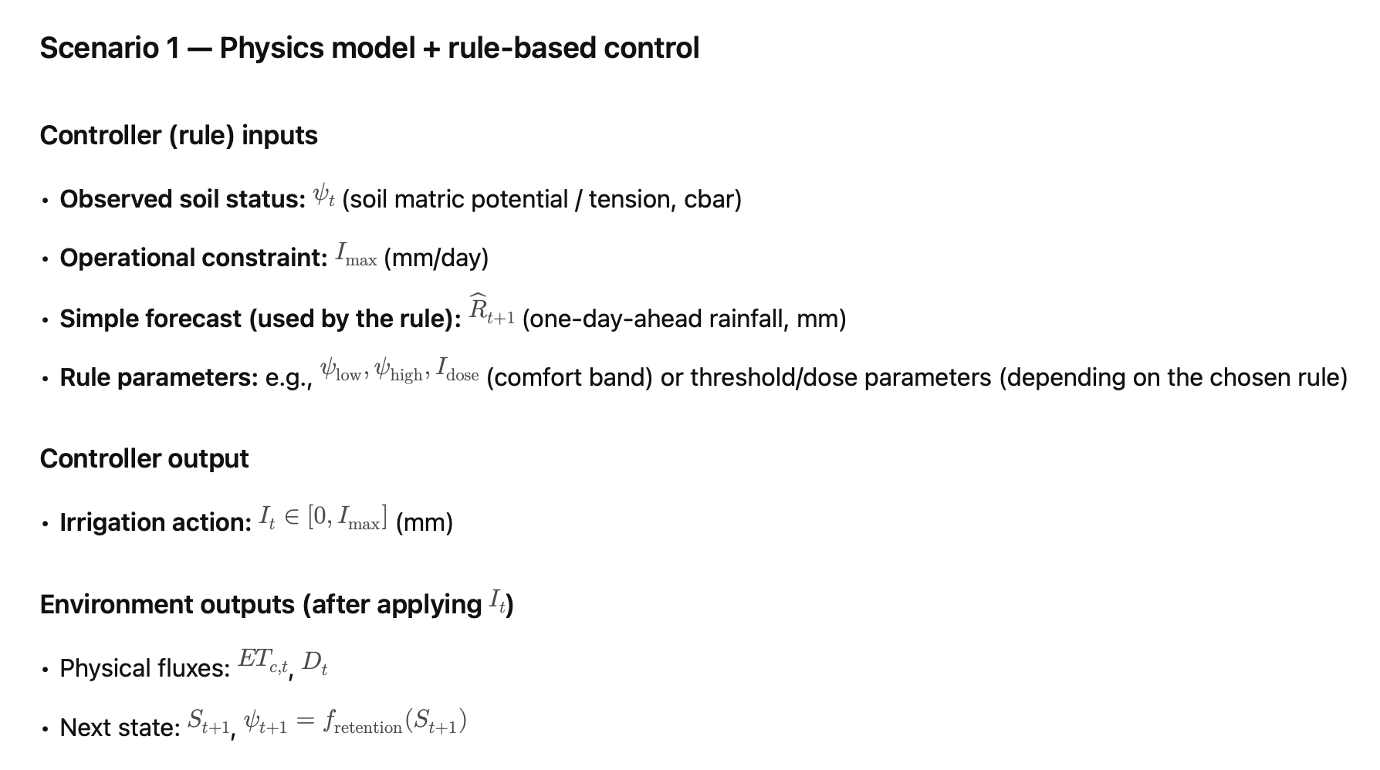
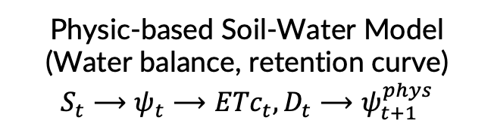
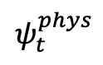
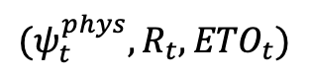
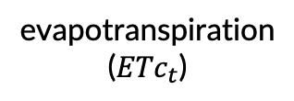
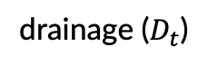

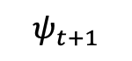
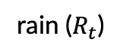
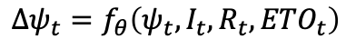
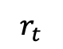
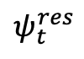
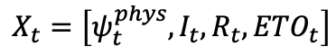
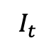
Climatic forcing
Stochastic Climate ($R_{t}, ETO$)
Physic-based Soil-Water Model
(Water balance, retention curve)
$$S_{t}⟶ψ_{t}⟶{ETc}_{t}, D_{t}⟶ψ_{t+1}^{phys}$$
$${(ψ}_{t}^{phys},R_{t},{ETO}_{t})$$
$$ψ_{t}^{phys}$$
evapotranspiration
(${ETc}_{t}$)
N-ODE
PPO
rain ($R_{t}$)
$$X_{t}=\left[ψ_{t}^{phys},I_{t},R_{t},{ETO}_{t}\right]$$
$$I_{t}$$
action
$$ψ_{t+1}$$
reward
$$r_{t}$$
$$ψ_{t}^{res}$$
$${Δψ}_{t}=f_{θ}\left(ψ_{t},I_{t},R_{t},{ETO}_{t}\right)$$
drainage ($D_{t}$)

Slide 12
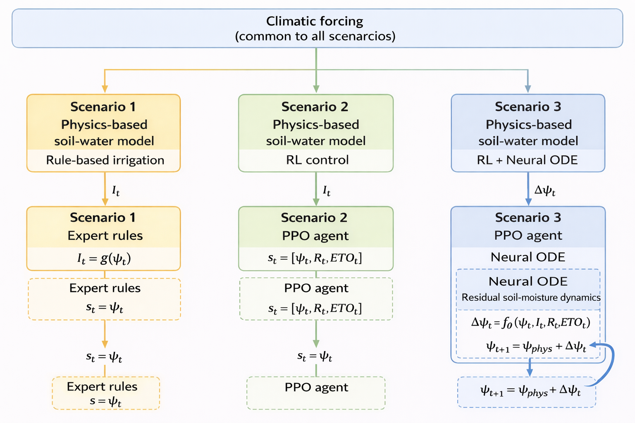
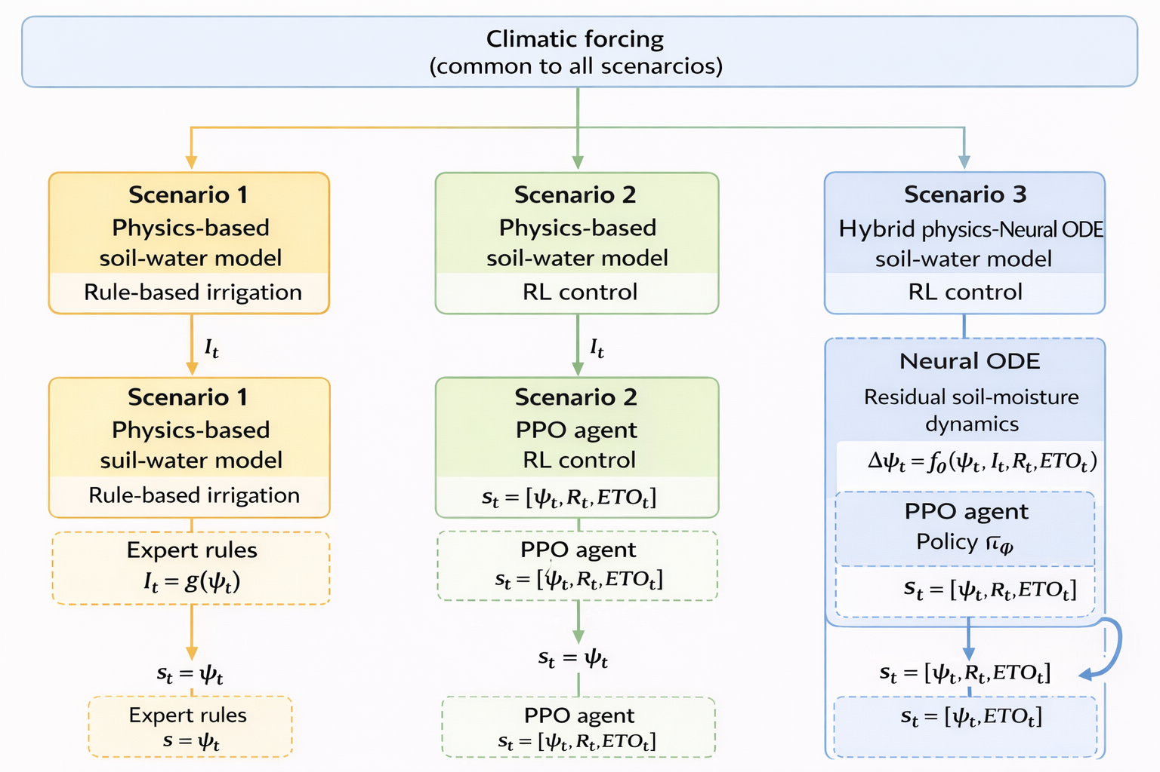
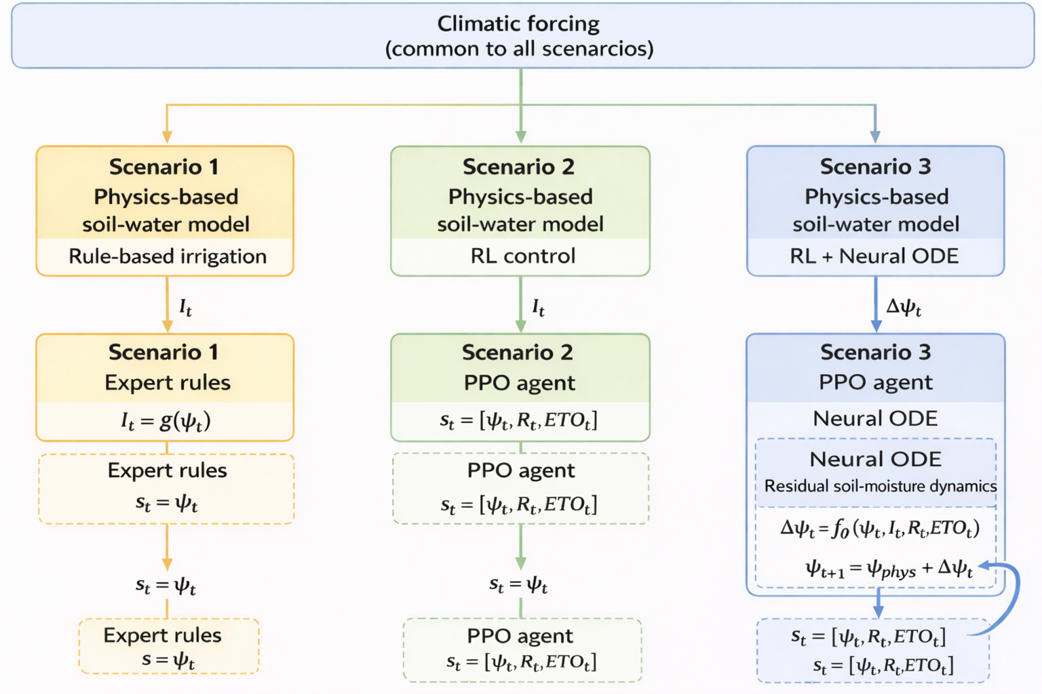

Slide 13



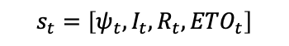
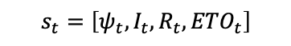
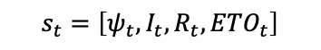
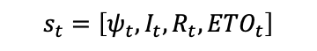


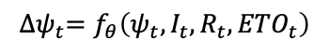
Climatic forcing
(common to all scenarios)
Scenario 1
Physics-based
soil-water model
Scenario 2
Physics-based
soil-water model
Scenario 3
Physics-based
soil-water model
Rule-base irrigation
RL control
Neuro ODE + RL control
Expert rules
PPO agent
Neural ODE
Residual soil-moisture dynamics
$$I_{t}=g\left(ψ_{t}\right)$$
$$s_{t}=\left[ψ_{t},I_{t},R_{t},{ETO}_{t}\right]$$
$${∆ψ}_{t}=f_{θ}\left(ψ_{t},{I_{t}, R}_{t},{ETO}_{t}\right)$$
PPO agent
$$s_{t}=\left[ψ_{t},{I_{t},R}_{t},{ETO}_{t}\right]$$
$$s_{t}=ψ_{t}$$
$$s_{t}=\left[ψ_{t},I_{t},R_{t},{ETO}_{t}\right]$$
$$s_{t}=\left[ψ_{t},I_{t},R_{t},{ETO}_{t}\right]$$

Slide 14


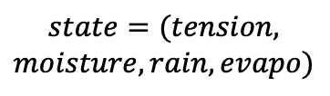

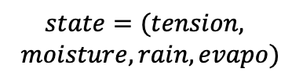
Climatic forcing
(common to all scenarios)
Scenario 1
Physics-based
soil-water model
Scenario 2
Physics-based
soil-water model
Scenario 3
Physics-based
soil-water model
Rule-base irrigation
RL control
Neuro ODE+RL control
Expert rules
PPO agent
Neural ODE
Residual soil-moisture dynamics
PPO agent
$$state=tension$$
$$state=(tension, moisture, rain, evapo)$$
$$state=(tension, moisture, rain, evapo)$$

Slide 15
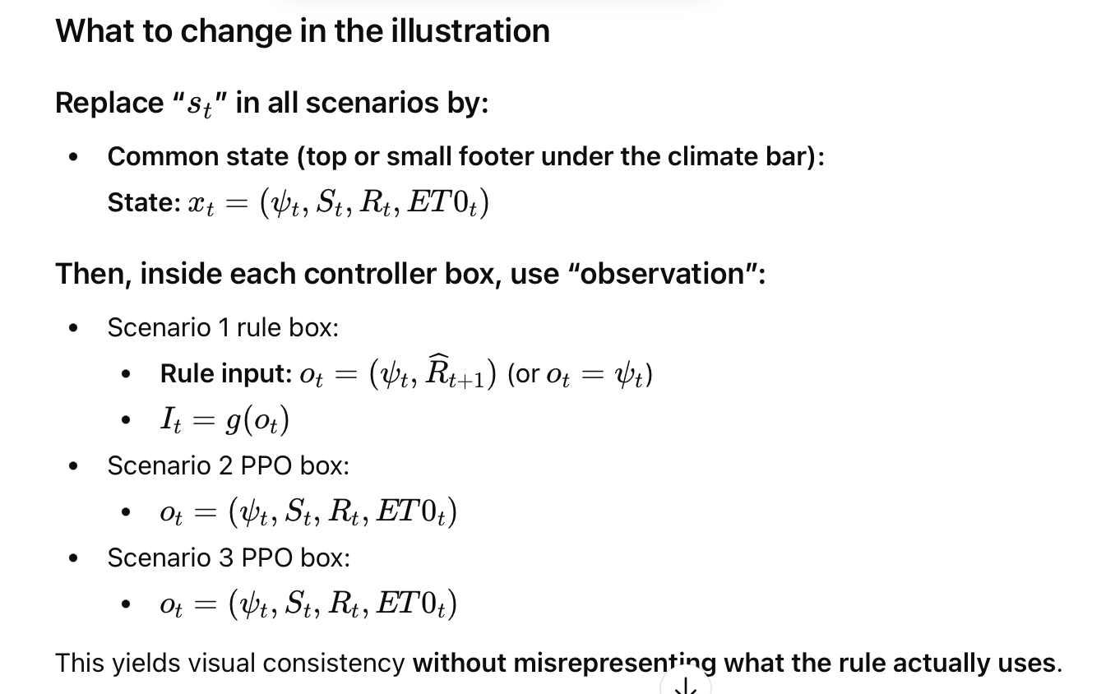


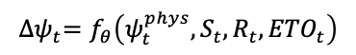





Climatic forcing
(common to all scenarios)
$$x_{t}=\left(ψ_{t}^{phys},S_{t},R_{t},{ETO}_{t}\right)$$
Scenario 1
Physics-based
soil-water model
Scenario 2
Physics-based
soil-water model
Scenario 3
Physics-based
soil-water model
Rule-base irrigation
RL control
Neuro ODE + RL control
Expert rules
PPO agent
Neural ODE
Residual soil-moisture dynamics
$$o_{t}=\left(ψ_{t}^{phys}, {\hat{R}}_{t+1}\right)$$
$$o_{t}=\left(ψ_{t}^{phys},S_{t},R_{t},{ETO}_{t}\right)$$
$${∆ψ}_{t}=f_{θ}\left(ψ_{t}^{phys},{S_{t}, R}_{t},{ETO}_{t}\right)$$
PPO agent
$$o_{t}=\left(ψ_{t}^{phys},{∆ψ}_{t},S_{t},R_{t},{ETO}_{t}\right)$$
$$I_{t}=g\left(o_{t}\right)$$
$$I_{t}=π_{φ}\left(o_{t}\right)$$
$$I_{t}=π_{φ}\left(o_{t}\right)$$

Slide 16


Slide 17
Forçage climatique
(commun à tous les scénarios)
$$x_{t}=\left(ψ_{t}^{phys},S_{t},R_{t},{ETO}_{t}\right)$$
Scénario 1
Modèle sol-eau basé sur la physique
Scénario 2
Modèle sol-eau basé sur la physique
Scénario 3
Modèle sol-eau basé sur la physique
Irrigation à base de règles
Contrôle par RL
Neuro ODE + Contrôle RL
Règles d’Expert
Agent PPO
Neural ODE
Dynamique résiduelle sol-humidité
$$o_{t}=\left(ψ_{t}^{phys}, {\hat{R}}_{t+1}\right)$$
$$o_{t}=\left(ψ_{t}^{phys},S_{t},R_{t},{ETO}_{t}\right)$$
$${∆ψ}_{t}=f_{θ}\left(ψ_{t}^{phys},{S_{t}, R}_{t},{ETO}_{t}\right)$$
Agent PPO
$$o_{t}=\left(ψ_{t}^{phys},{∆ψ}_{t},S_{t},R_{t},{ETO}_{t}\right)$$
$$I_{t}=g\left(o_{t}\right)$$
$$I_{t}=π_{φ}\left(o_{t}\right)$$
$$I_{t}=π_{φ}\left(o_{t}\right)$$

Slide 20





Slide 21



Slide 22







Slide 23




